Slide 1

Riemannian Deep Learning:
Normalization and Classification
Ziheng Chen
Supervisor: Nicu Sebe
University of Trento
MHUG Lab

Slide 2
Research Route
Riemannian Deep Learning
N
Normalization
C
Classification
G
Geometry
Architecture
A
Lie Group [2]
Gras. Att. [4]
Ada. Metrics [6]
Interpreting GCP [8]
LieBN
GLDNet
ALEM
GCP as MLR
G
AAAI 23
N
CVPR 24
A
NeurIPS 24
G
ICLR 25
C
CVPR 25
A
ICLR 24
C
IJCAI 24
C
TIP 24
N
ICLR 25
N
G
MSNet
SPD MLR
RMLR
GyroBN
GBWBN
Submanifold [1]
Flat SPD [3]
SPD & Rotation [5]
Gyrogroup [7]
Ill-conditioning [9]
[1] Chen Z, et al. Riemannian local mechanism for SPD neural networks. AAAI 2023
[2] Chen Z, et al. A Lie group approach to Riemannian batch normalization. ICLR 2024
[3] Chen Z, et al. Riemannian multinomial logistics regression for SPD neural networks. CVPR 2024
[4] Wang R, Hu C, Chen Z†, et al. A Grassmannian manifold self-attention network for signal classification. IJCAI 2024
[5] Chen Z, et al. Adaptive Log-Euclidean metrics for SPD matrix learning. IEEE TIP 2024.
[6] Chen Z, et al. RMLR: Extending Multinomial Logistic Regression into General Geometries. NeurIPS 2024
[7] Chen Z, et al. Gyrogroup Batch Normalization. ICLR 2025
[8] Chen Z, et al. Understanding matrix function normalizations in covariance pooling through the lens of Riemannian geometry. ICLR 2025
[9] Wang, R, Jin, S, Chen, Z†, et al. Learning to Normalize on the SPD Manifold under Bures-Wasserstein Geometry. CVPR 2025.

Slide 3
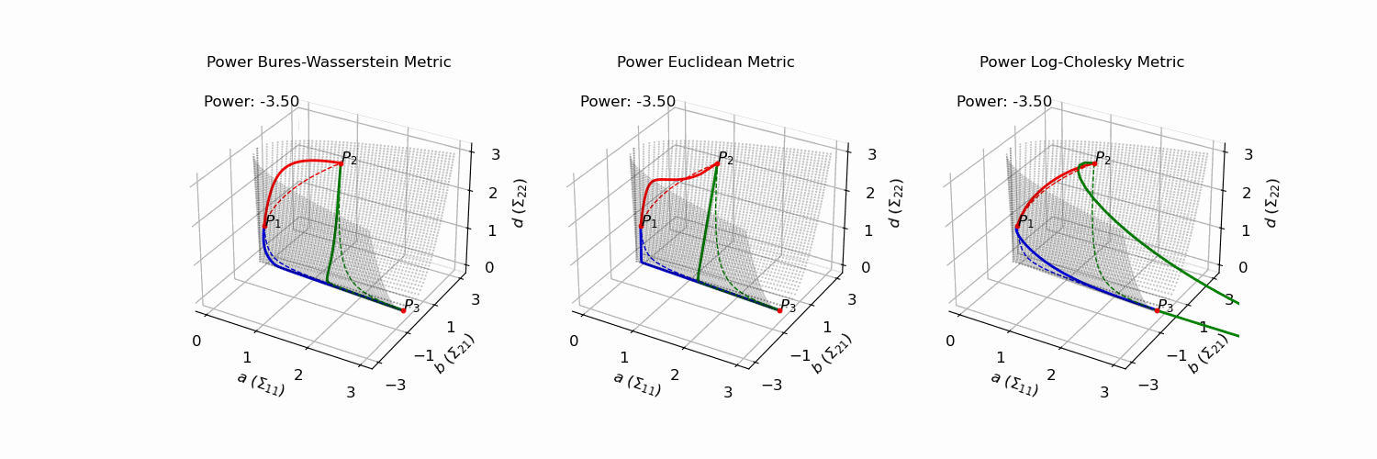
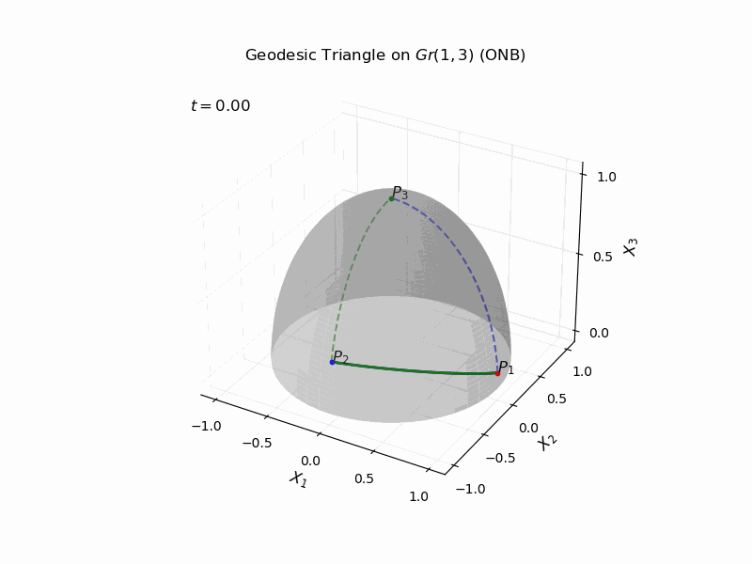
Backgrounds
Manifolds differ with the Euclidean space

Slide 4
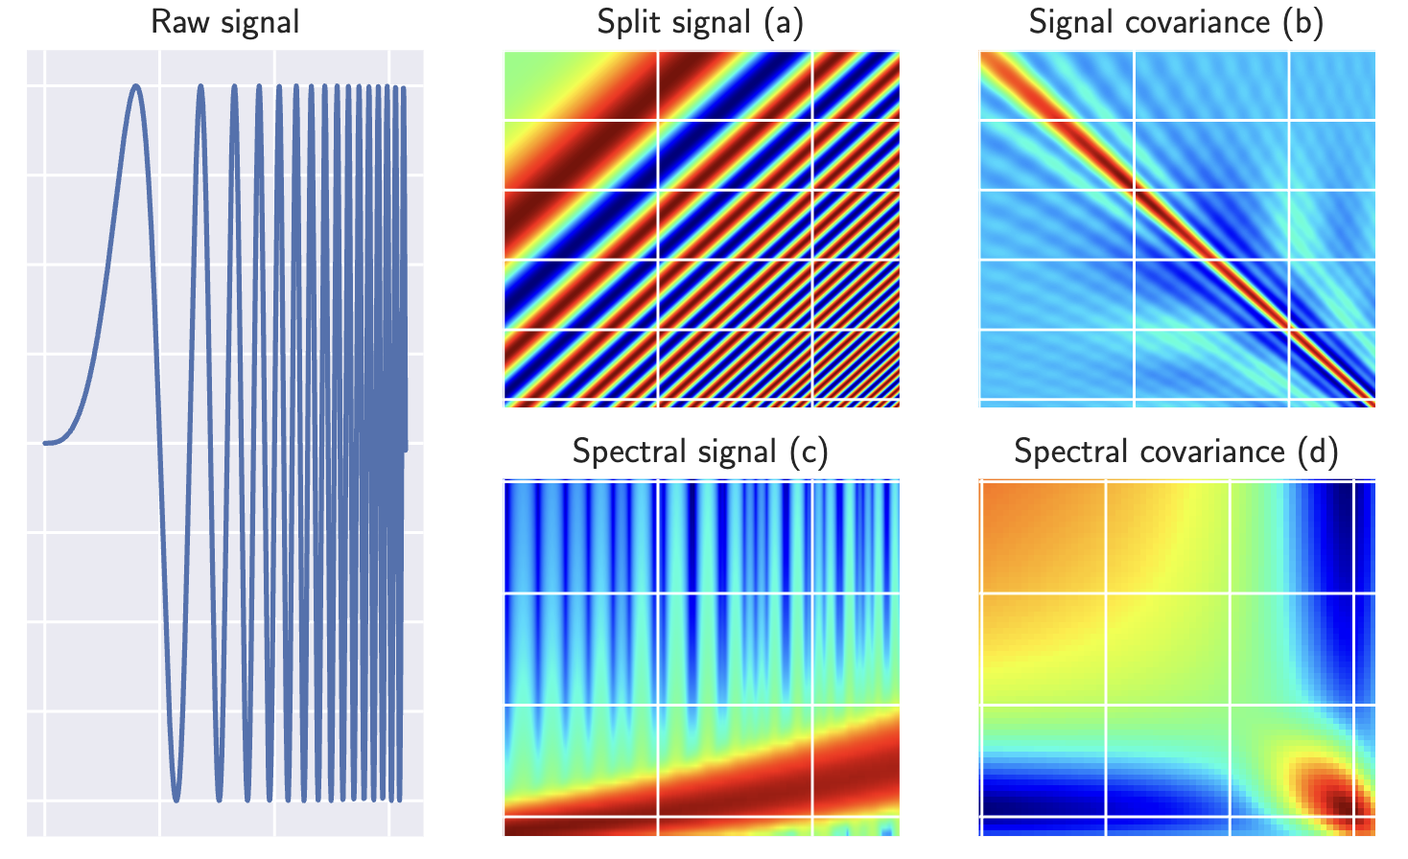
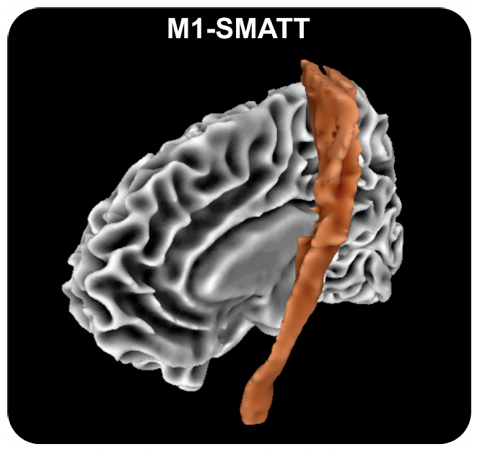
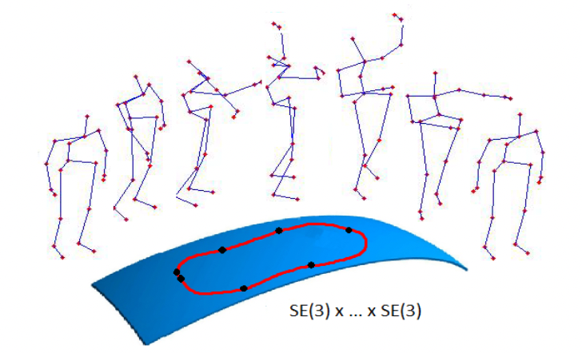
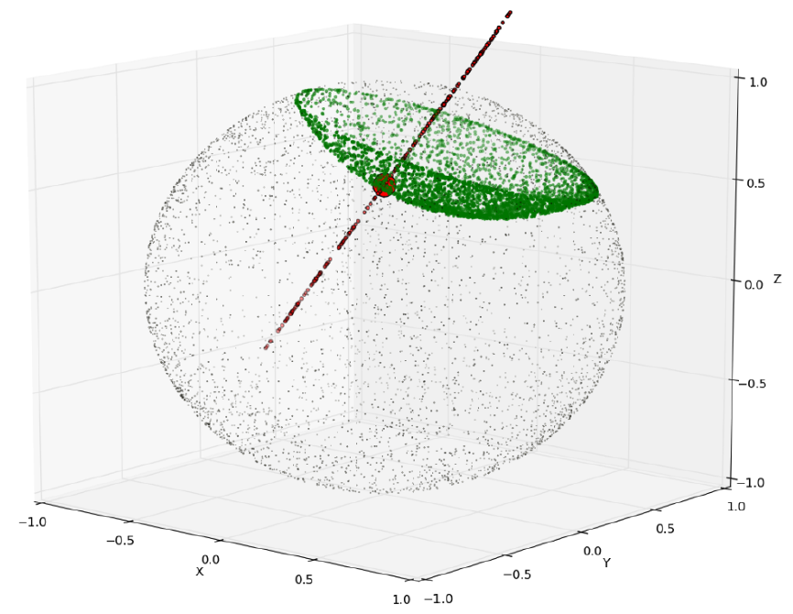
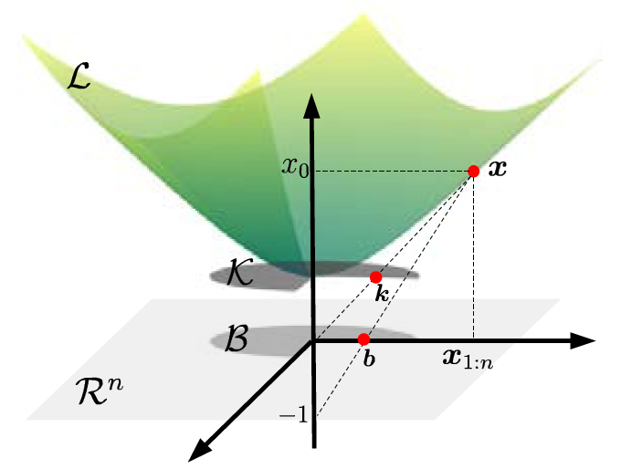
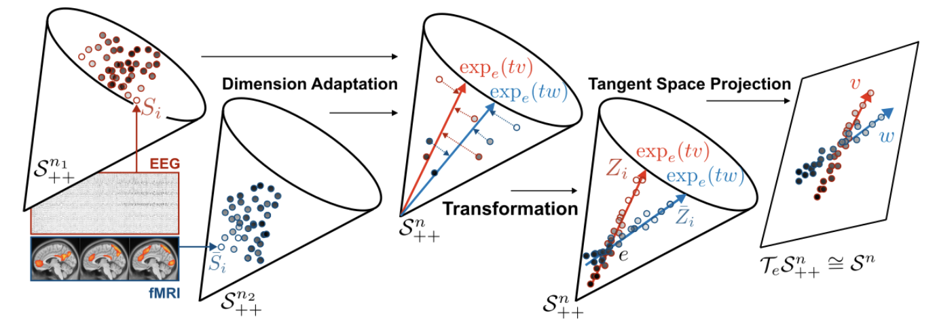
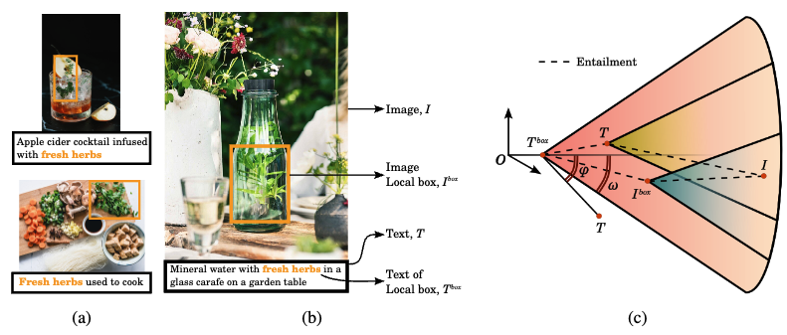
Motivations
Radar Classification
Medical Imaging
Action Recognition
NLP, Graph …
Ganea et al., 2018
Dai et al., 2021
Brooks et al., 2020
Chakraborty et al., 2020
Vemulapalli, Raviteja 2014
Brain-Computer Interfaces
Vision-Language Models
Ju et al., 2024
Pal et al., 2025
Brooks, Daniel, et al. "Deep learning and information geometry for drone micro-Doppler radar classification." RadarConf, 2020.
Chakraborty R et al. Manifoldnet: A deep neural network for manifold-valued data with applications. T-PAMI, 2020
Vemulapalli, Raviteja, et al. Human action recognition by representing 3D skeletons as points in a lie group. CVPR. 2014.
Ju, Ce, et al. "Deep geodesic canonical correlation analysis for covariance-based neuroimaging data." ICLR, 2024.
Pal A, et al. Compositional Entailment Learning for Hyperbolic Vision-Language Models. ICLR 2025
Ganea, O., Bécigneul, G., & Hofmann, T. (2018). Hyperbolic neural networks. NeurIPS, 31.
Dai, J., Wu, Y., Gao, Z., & Jia, Y. (2021). A hyperbolic-to-hyperbolic graph convolutional network. CVPR, 2021

Slide 5
A Blueprint of Manifolds
Riemannian manifold
Locally Euclidean metric
Mani·fold
Riemannian metric
Group
Lie group
Differential manifold
Locally Euclidean analysis
Smooth structure
Group
Topological group
Topological manifold
Locally Euclidean topology
Topology
set
Algebraic structure
Geometric structure
https://en.wikipedia.org/wiki/Tangent_space
Armstrong M A. Basic topology[M]. Springer Science & Business Media, 2013.
Lee J M. Smooth manifolds[M]. Introduction to Smooth Manifolds. Springer, New York, NY, 2013: 1-31.
Do Carmo M P, Flaherty Francis J. Riemannian geometry[M]. Boston: Birkhäuser, 1992.

Slide 6
Geometric Intuition
Vector space
Riemannian manifold
Line
Geodesic
Line segment
Riemannian logarithm
Moving along a direction
Riemannian exponential
Weighted average mean
Weighted Fréchet mean (WFM)
Moving a line
Levi-Civita parallel transportation
distance
Geodesic distance

Slide 7
Geometric Intuition
Geometric Reinterpretation of some Vector Operations
Pennec X, Fillard P, Ayache N. A Riemannian framework for tensor computing[J]. International Journal of computer vision, 2006, 66(1): 41-66.

Slide 8
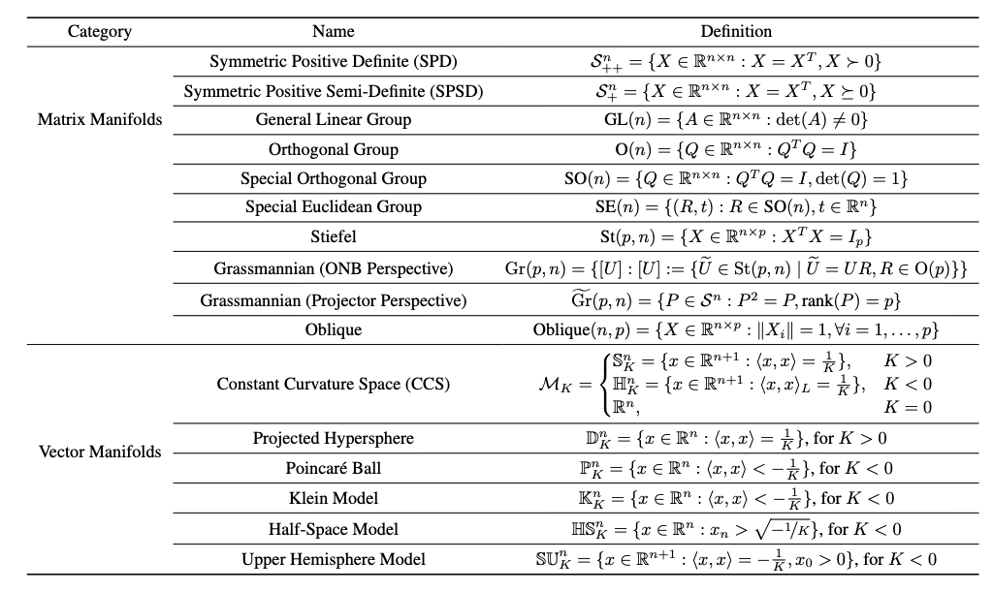
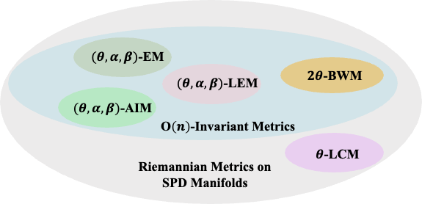
Examples
Examples in Machine Learning
Manifold: Locally Euclidean
There could be multiple metrics on a manifold
Chen Z, et al. RMLR: Extending Multinomial Logistic Regression into General Geometries. NeurIPS 2024

Slide 9
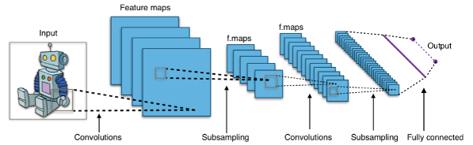
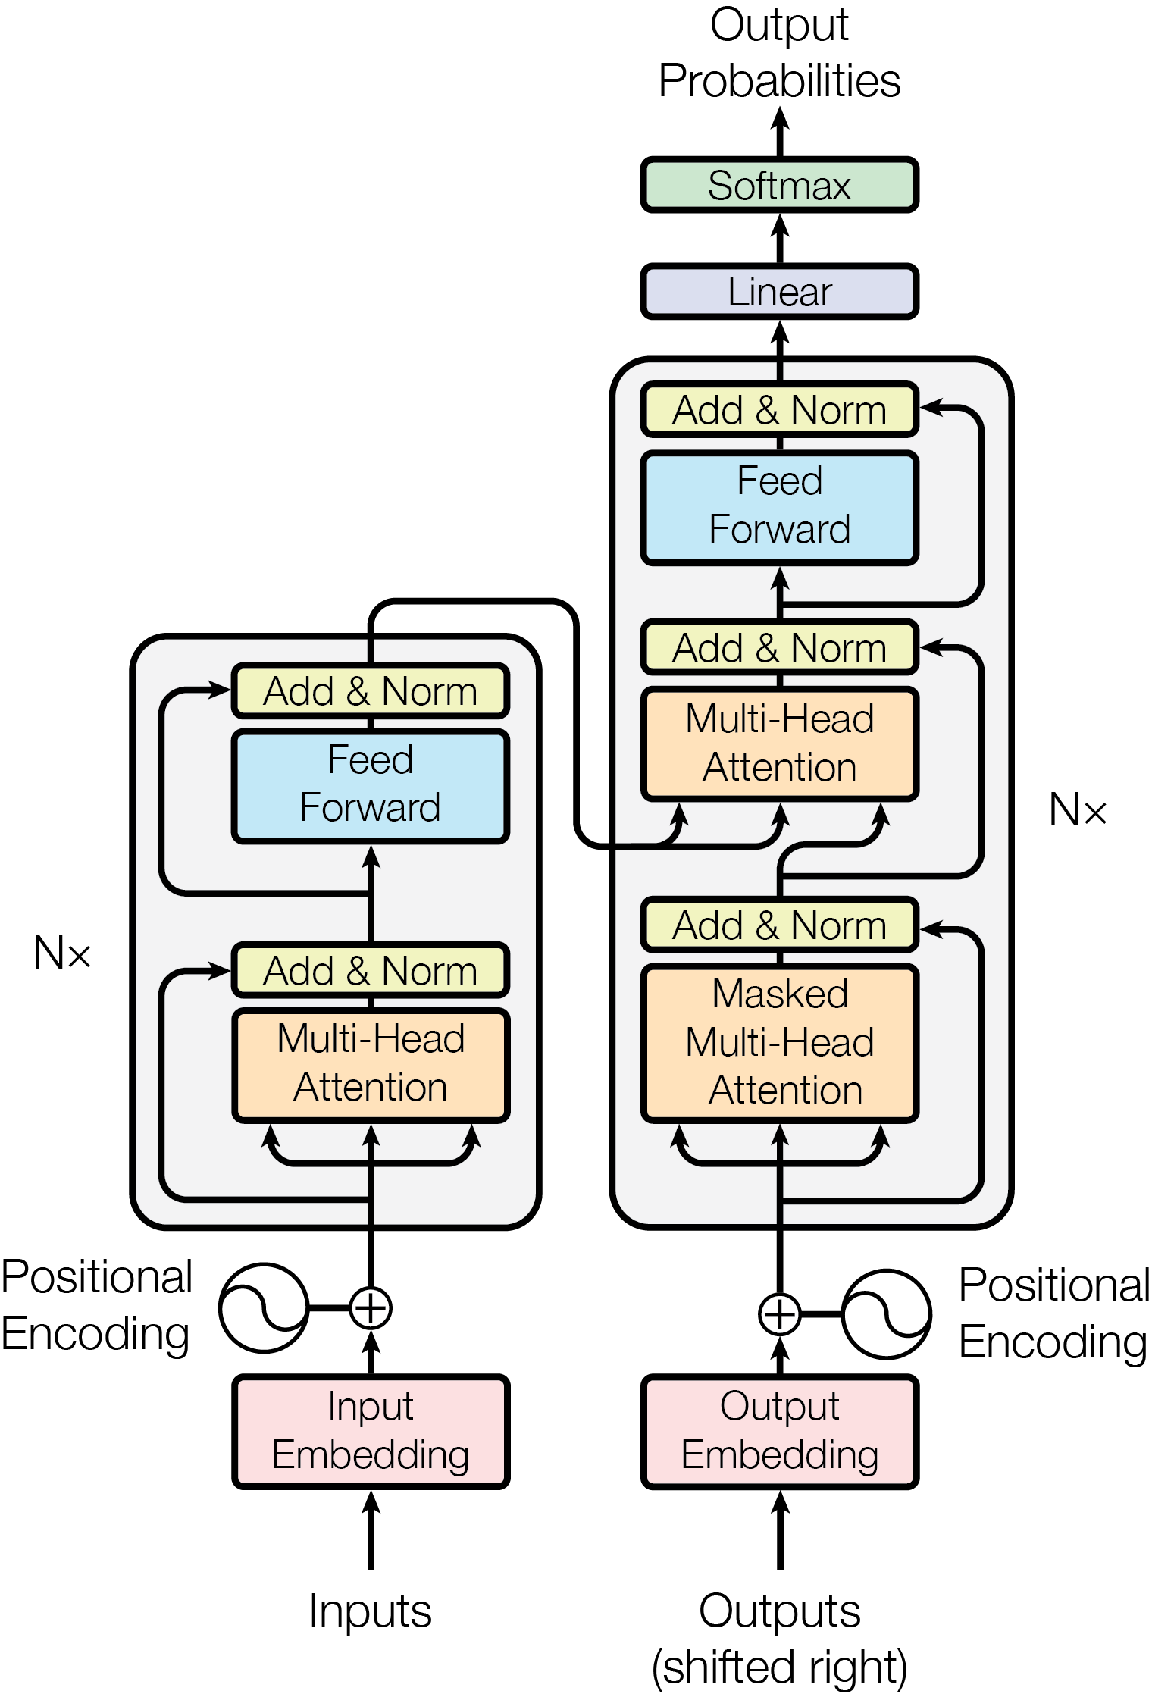
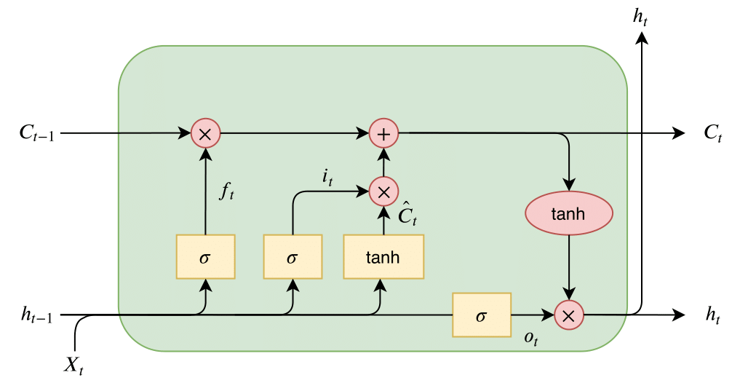
Deep Learning: from Euclidean to Riemannian
CNNs
RNNs
ResNet
Transformer
Basic building blocks
Transformation
Activation
Normalization
Classification
Intrinsically
Riemannian Spaces
Hochreiter S, Schmidhuber J. Long short-term memory[J]. Neural computation, 1997, 9(8): 1735-1780.
Krizhevsky A, Sutskever I, Hinton G E. Imagenet classification with deep convolutional neural networks[J]. NeurIPS,2012.
He K, Zhang X, Ren S, et al. Deep residual learning for image recognition. CVPR. 2016.
Vaswani A, Shazeer N, Parmar N, et al. Attention is all you need[J]. NeurIPS, 2017.

Slide 10
Riemannian Normalization

Slide 11
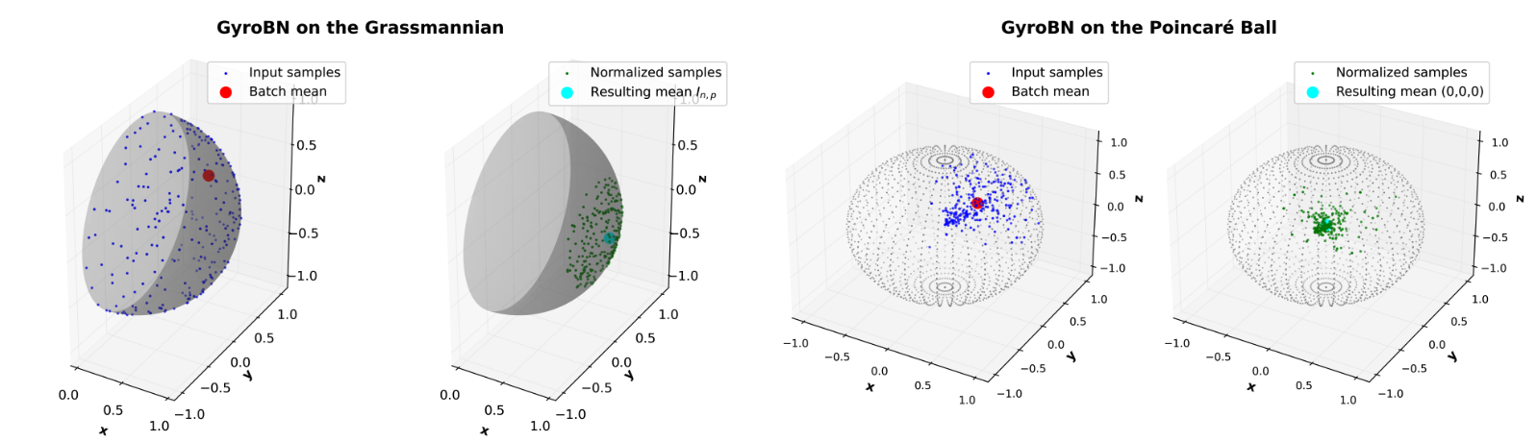
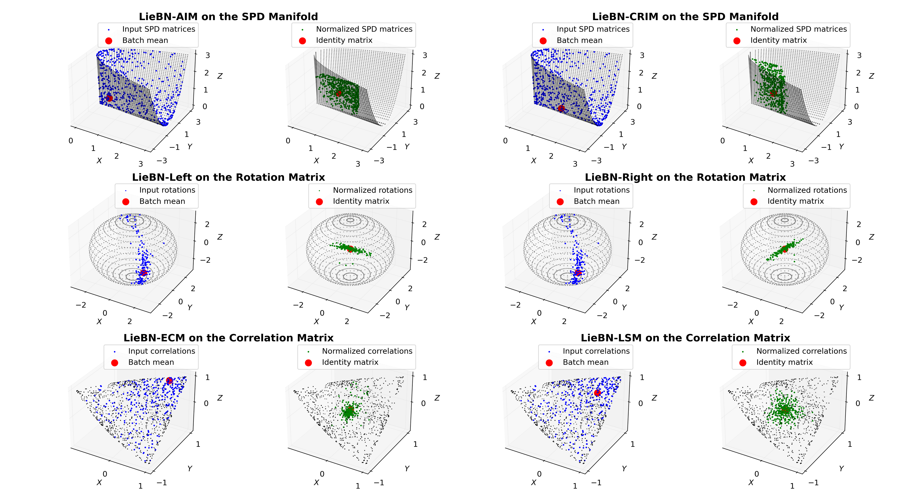
Overview: Riemannian Normalization
GyroBN (ICLR24)
LieBN (ICLR24)
LieBN-Extension (PAMI; under review)
GBWMBN for ill-conditioning (CVPR25)
Chen Z, et al. A Lie group approach to Riemannian batch normalization. ICLR 2024
Chen Z, et al. LieBN: Batch Normalization over Lie Groups. under review
Chen Z, et al. Gyrogroup Batch Normalization. ICLR 2025
Wang, R., Jin, S., Chen, Z.†, et al. Learning to Normalize on the SPD Manifold under Bures-Wasserstein Geometry. CVPR 2025.
Notes:
We focus on the Batch Normalization

Slide 12
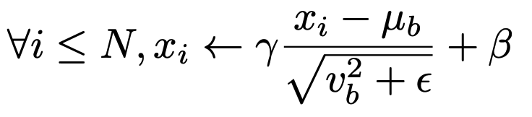
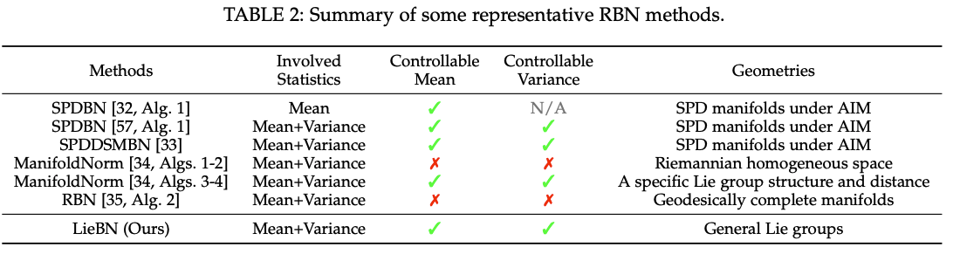
Revisiting Batch Normalization
Euclidean Normalization: facilitating network training by controlling mean and variance
All the previous RBN methods fail to control statistics in a principled manner
Several manifold manifold-valued features form Lie groups
Chen Z, et al. A Lie group approach to Riemannian batch normalization. ICLR 2024

Slide 13
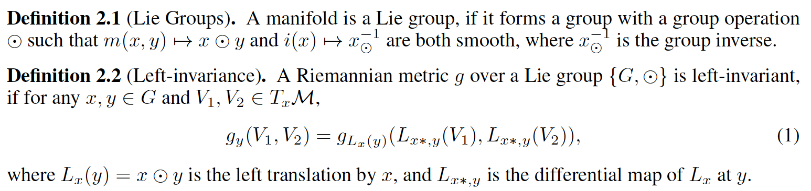
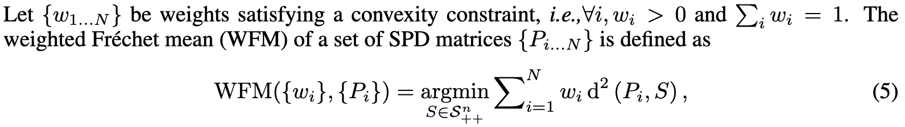
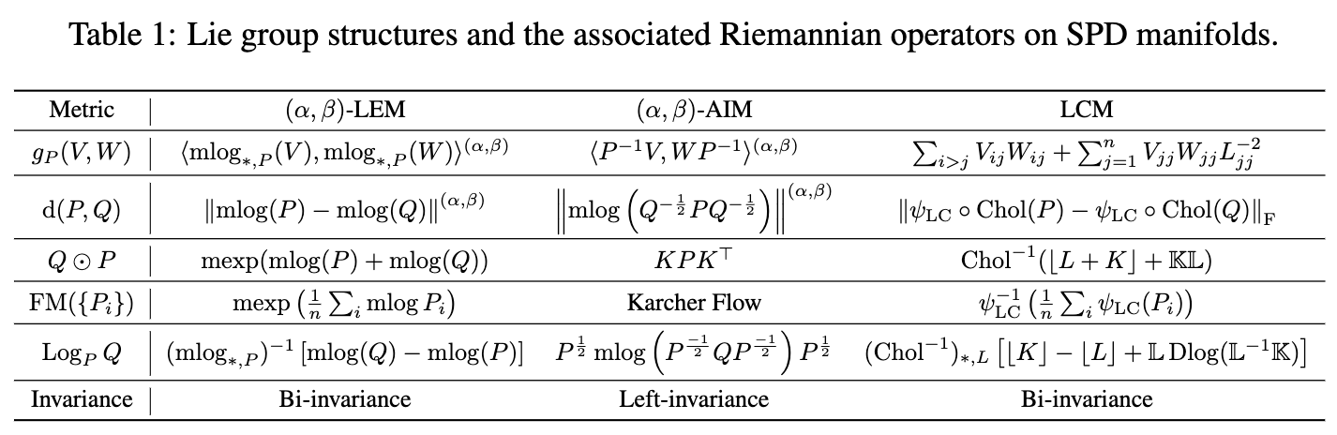
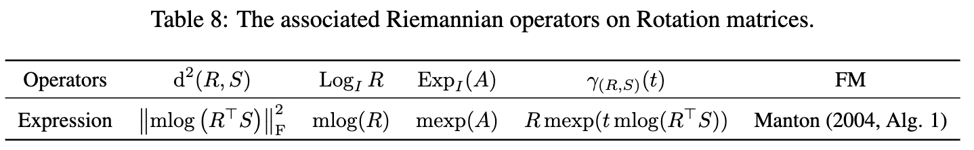
Lie Structures
Lie Groups
Examples

Slide 14
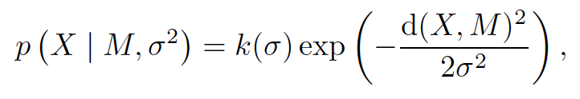
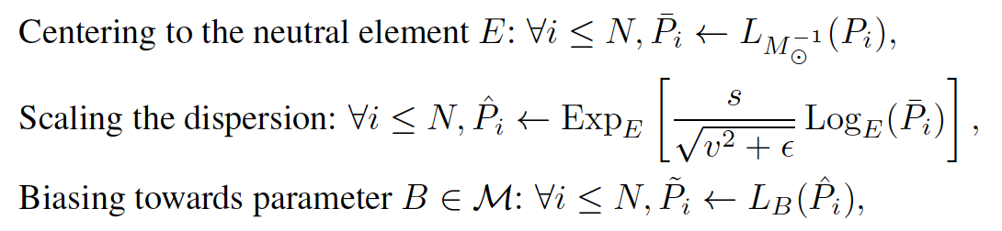
Construction
Gaussian
Mean and variance
Centering, biasing, scaling
Euclidean BN
Gaussian on manifolds:
LieBN
Question
Can they normalize sample statistics?

Slide 15
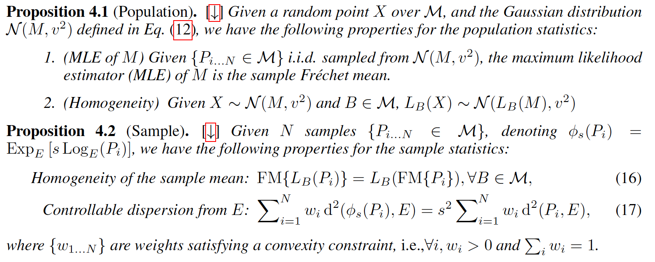
Properties
Yes

Slide 16
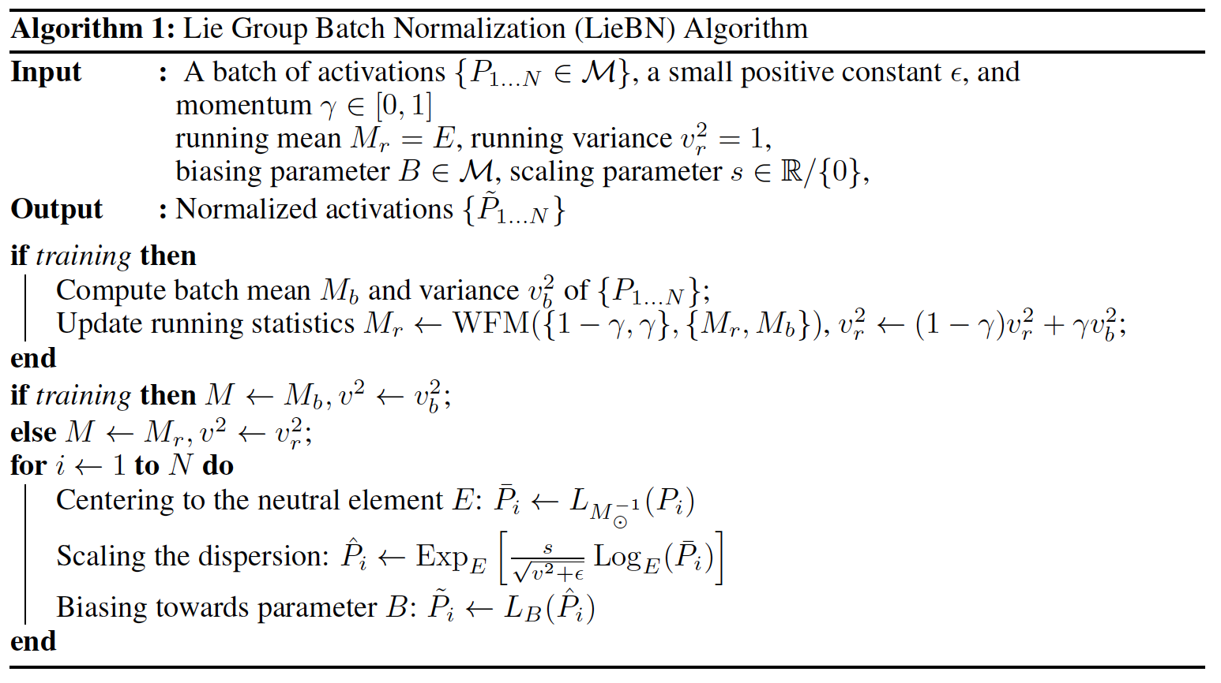
Algorithm
A natural extension of the Euclidean BN:

Slide 17
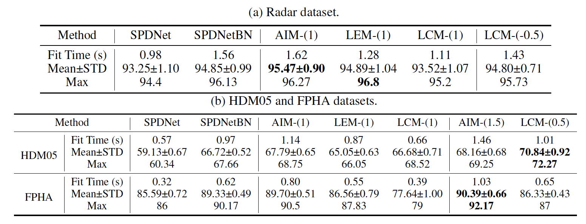
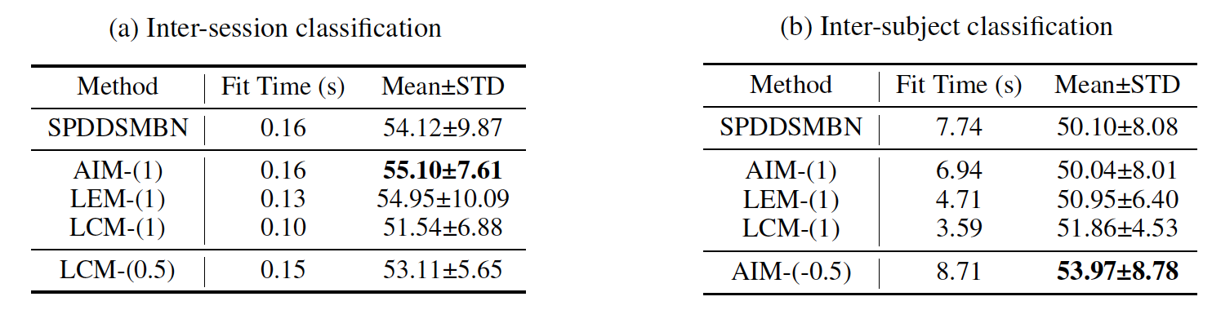
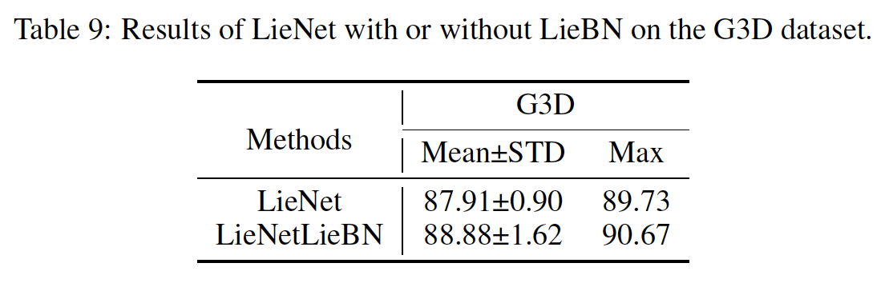
Experiments
Radar
Skeleton
EEG
SO(3)

Slide 18
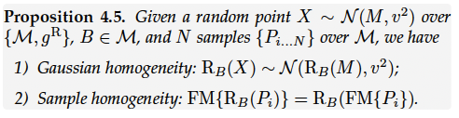
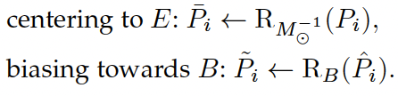
LieBN: from left-invariance to right-invariance
Chen Z, et al. LieBN: Batch Normalization over Lie Groups. under review

Slide 19
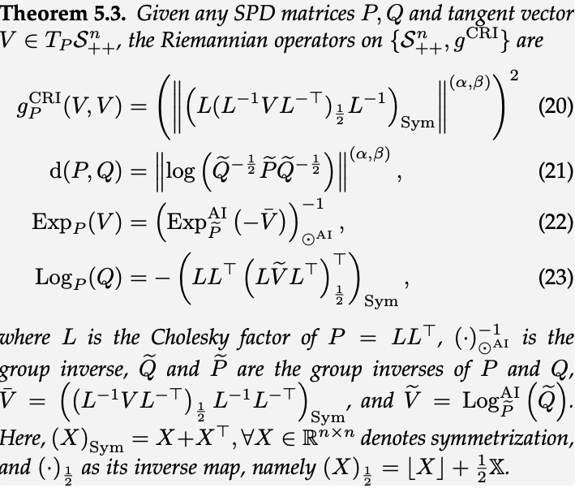
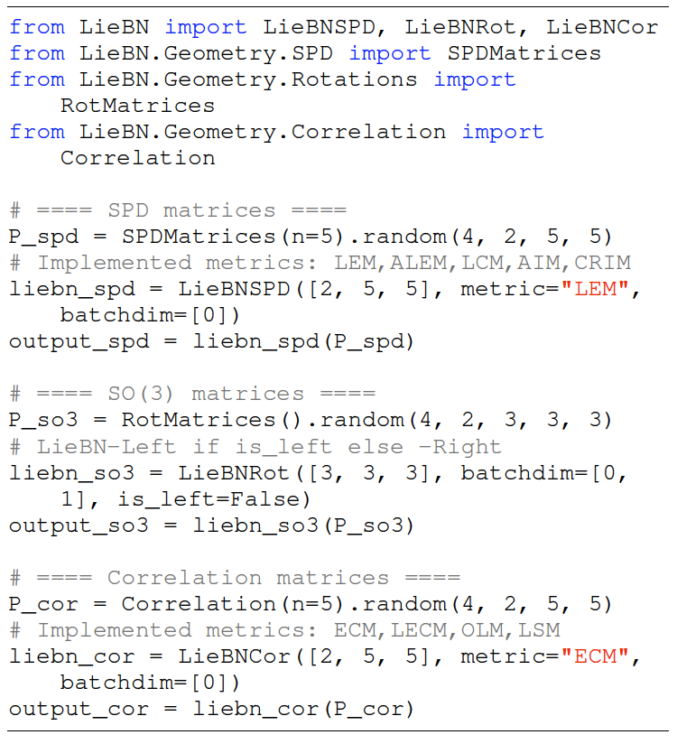
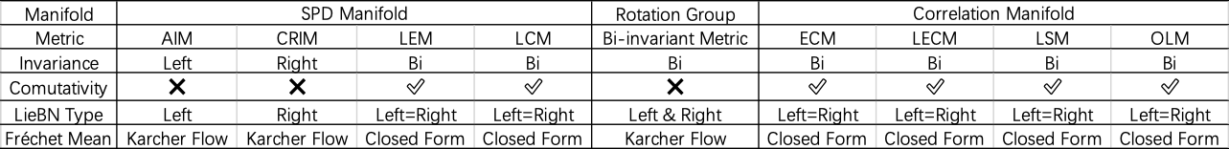
LieBN: from left-invariance to right-invariance
First non-trivial right-invariant SPD metric
Demo of the released toolbox
Nine implementations

Slide 20
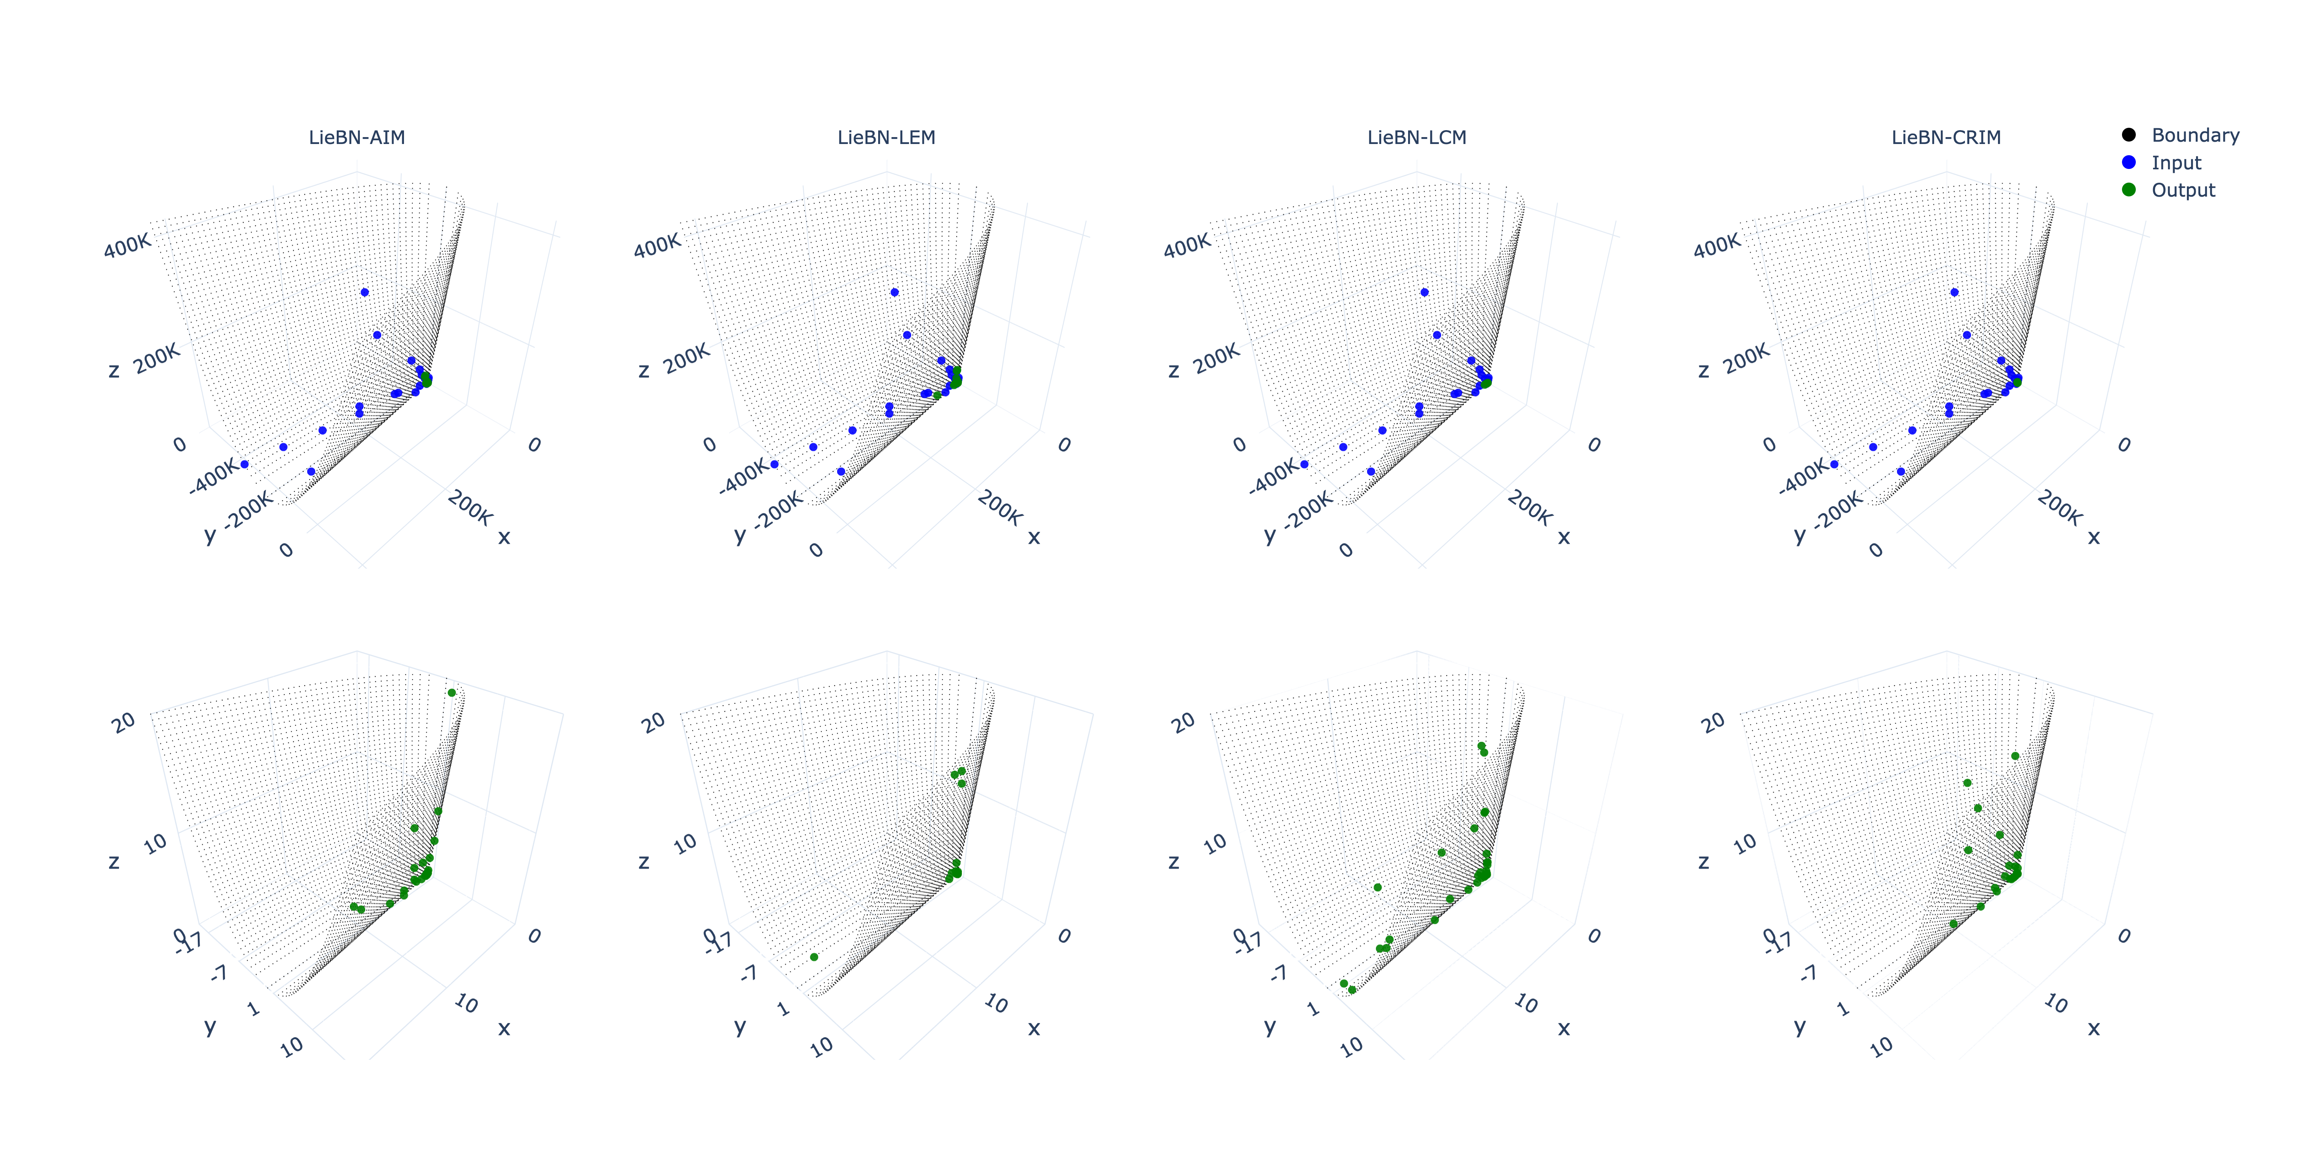
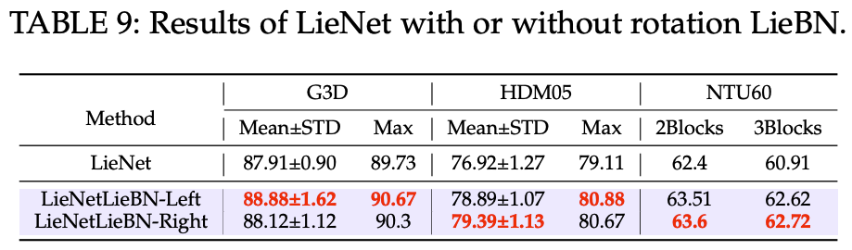
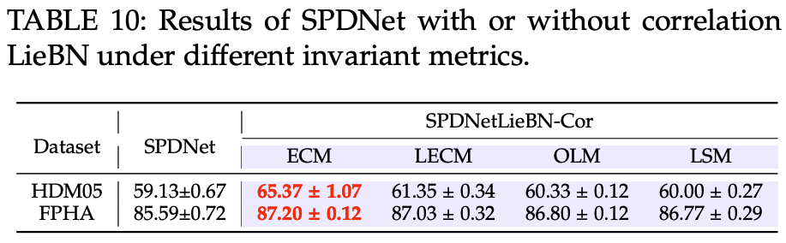
Experiments
Visualization
(at a different scale)

Slide 21
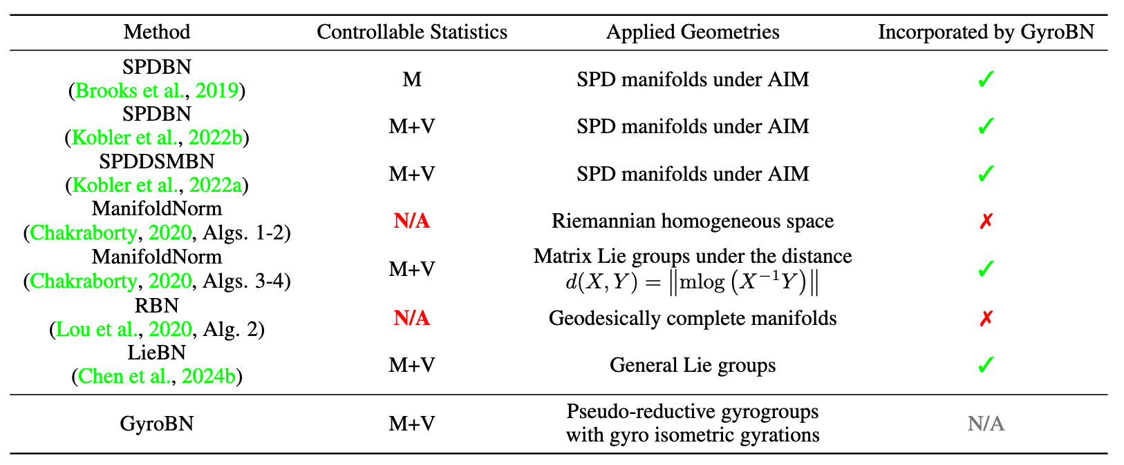
RBN: From Lie Groups to Gyro Groups
How about manifold without Lie group structures?
Grassmannian
Hyperbolic
GyroBN
Generality: incorporating several previous RBN methods
Chen Z, et al. Gyrogroup Batch Normalization. ICLR 2025

Slide 22
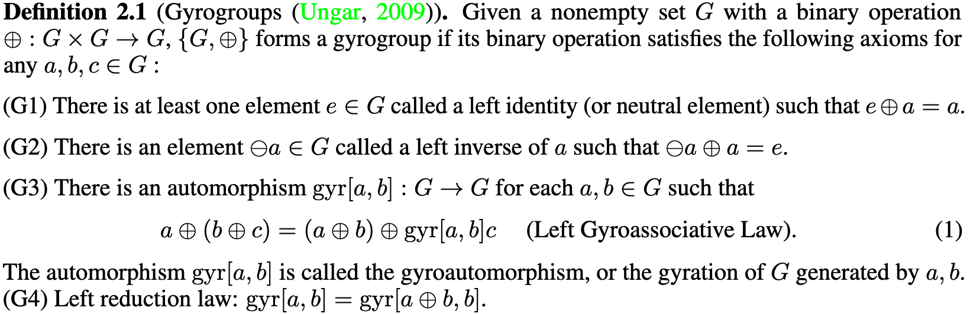
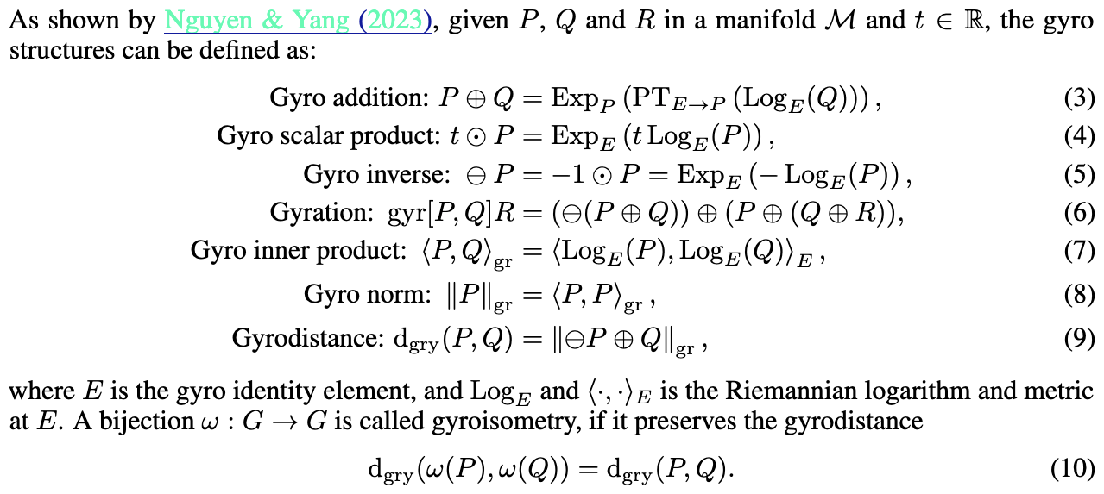
Gyro Structures
Gyrogroups
Non-associative group
Gyrations
Gyro Structures
Extends the vector structures

Slide 23
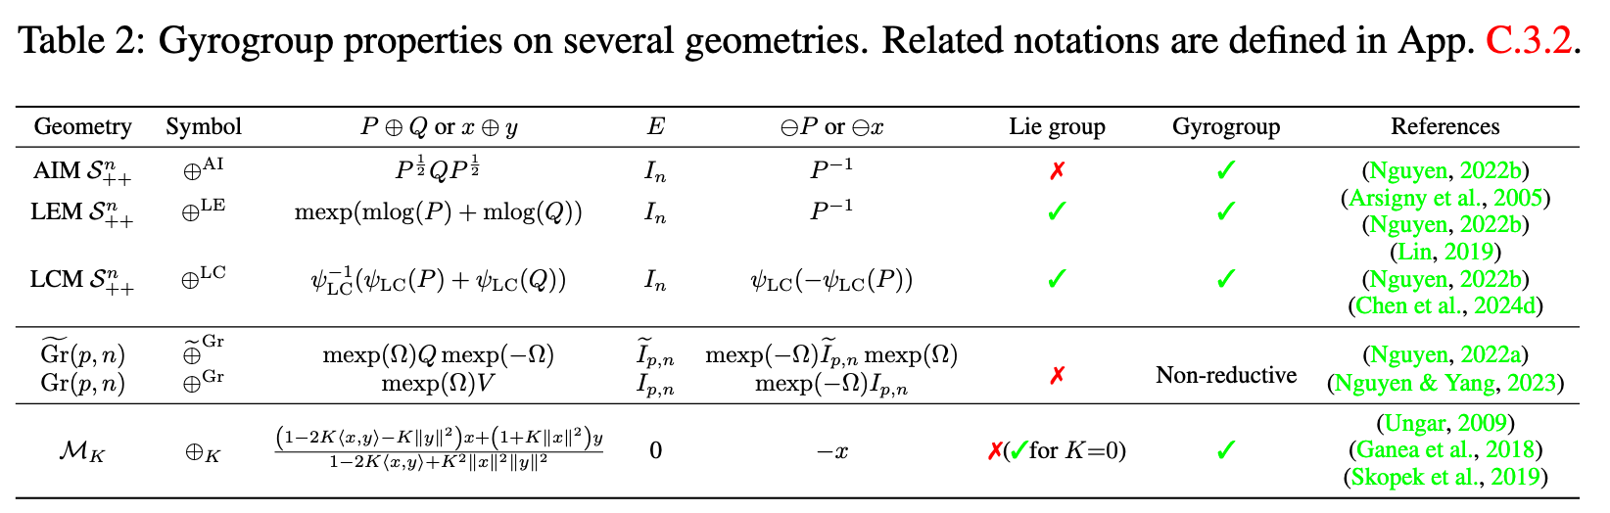
Examples
Several geometries do not form Lie groups, but gyrogroups.

Slide 24
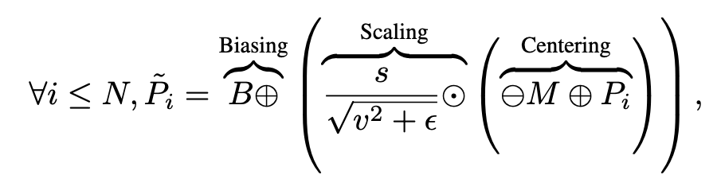
GyroBN
Gyro
Construction
Question
Calculation of the gyro statistics
Ability to normalize the sample statistics?

Slide 25
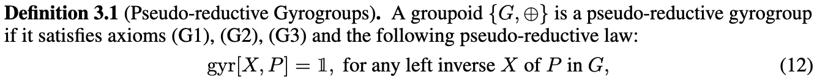
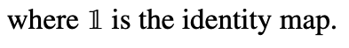
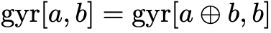
Theories
Slacked
Definition
Results
Insight:
Gyro mean and variance ⇔ Riemannian mean and variance
Gyro operations can normalize sample statistics

Slide 26
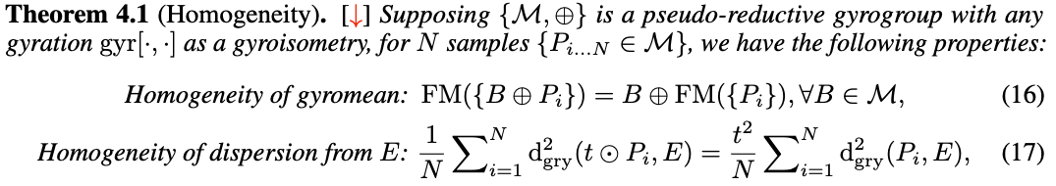
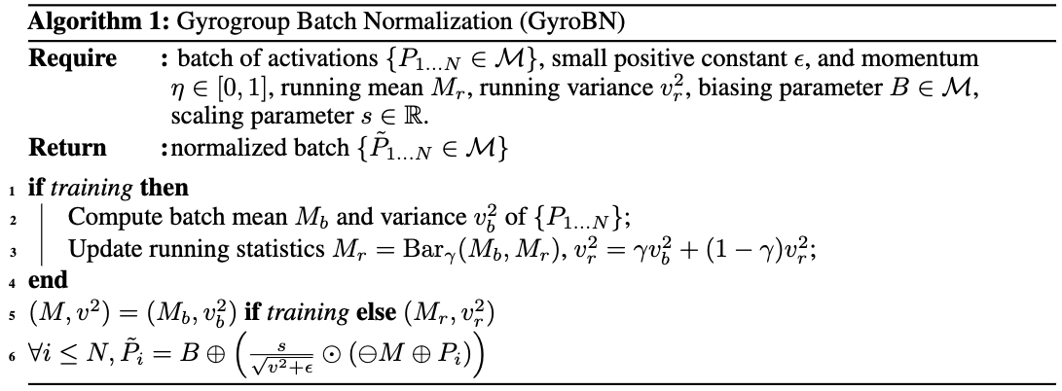
Theories
Guarantee
Algorithm
Generality: incorporating several previous RBN methods

Slide 27
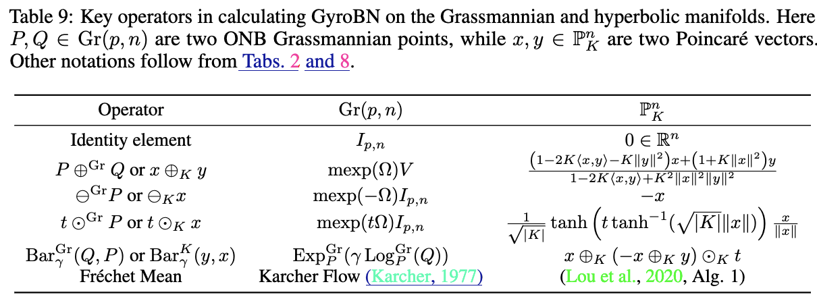
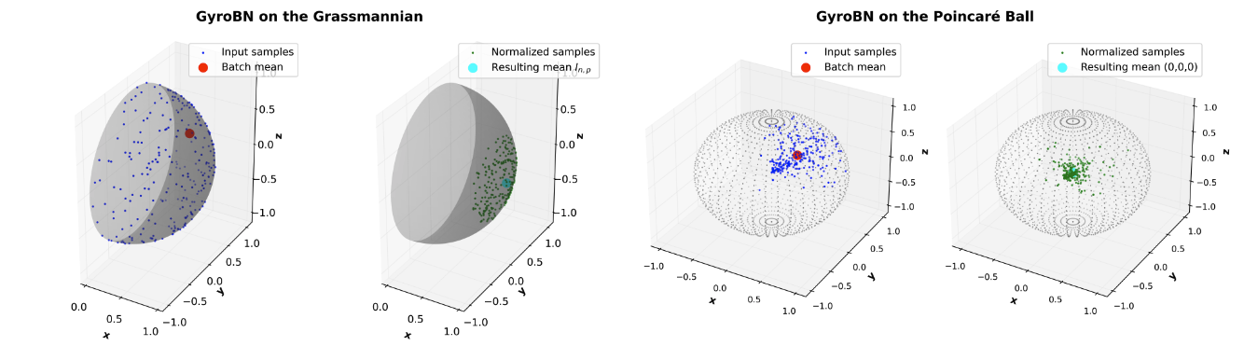
Experiments
Instantiations
Visualization

Slide 28
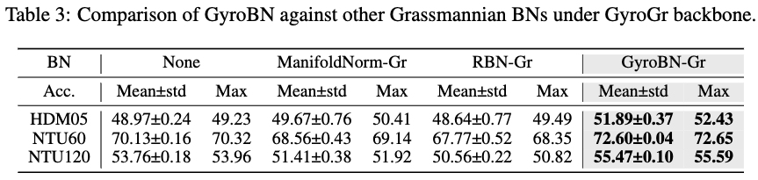

Experiments
Grassmannian
Hyperbolic

Slide 29

GWBMBN for Ill-Conditioned SPD Matrix Learning
Ill-conditioning
Overwhelming
Wang R, Jin S, Chen Z†, et al, Learning to Normalize on the SPD Manifold under Bures-Wasserstein Geometry, CVPR 2025

Slide 30

GWBMBN for Ill-Conditioned SPD Matrix Learning
AIM: quadratic
BWM: linear

Slide 31


GWBMBN for Ill-Conditioned SPD Matrix Learning
Construction
Simplification
Power-deformed generalized BWM is simplified by Riemannian isometries

Slide 32


GWBMBN for Ill-Conditioned SPD Matrix Learning
EEG
RResNet
Limitation
Fail to normalize sample mean
Solution
Invariance (in progress)

Slide 33
Riemannian Classifiers

Slide 34


Overview: Riemannian Multinomial Logistics Regression
Flat MLR (CVPR24) ⇒ RMLR (NeurIPS24)
RieGCP (ICLR25)
Chen Z, et al. Riemannian multinomial logistics regression for SPD neural networks. CVPR 2024
Chen Z, et al. RMLR: Extending Multinomial Logistic Regression into General Geometries. NeurIPS 2024
Chen Z, et al. Understanding matrix function normalizations in covariance pooling through the lens of Riemannian geometry. ICLR 2025

Slide 35

Riemannian Multinomial Logistics Regression
Margin distance to hyperplane
Euclidean
SPD
Crux

Slide 36



Manifestation
Flat Geom.
SPD
Question
What about in other geometries?

Slide 37


Reformulation by Riemannian Trigonometry
Reformulation
Riemannian trigonometry

Slide 38



From Flat Metrics to General Geometries
Margin Distance
MLR
Generality

Slide 39


Manifestations
SPD MLR
Lie MLR

Slide 40




Results
Riem. FFNN
Riem. GCN
RResNet
SO(n)

Slide 41

Understanding Matrix Functions in GCP
Typical GCP
Discrepancy
Explanation
Chen Z, et al. Understanding matrix function normalizations in covariance pooling through the lens of Riemannian geometry. ICLR 2025

Slide 42


Preliminaries
Seven power-deformed metrics on SPD the manifold.
Matrix logarithm and power:

Slide 43



Tangent Perspective
Matrix logarithm as the Riem. log
Motivation
Riem. log
Refuted

Slide 44



Riemannian Perspective
SPD MLR
Motivation
Matrix logarithm implicitly construct an SPD MLR (CVPR24)
RMLR
Comparison

Slide 45



Experiments
Results
Ablations

Slide 46
Discussion
Quick summary
Theoretical framework for batch normalization, classifiers on Riemannian space
Manifestations on different geometries
Interpreting GCP in Euclidean deep learning
Future work
Riemannian transformation layer
Riemannian optimal transport
Visualization of high-dimensional Riemannian manifolds
Applications into large models
Generative models with differential geometry

Slide 47



Thanks
Thanks!
WeChat
LinkedIn
Homepage

